Slide 1

Template for CISO’s Presentation to Board Audit Committee or to the Board of Directors

Slide 2
Using this Presentation Template
delete this slide after use
This presentation template will help you organize your presentation to the board of directors (or the board audit committee). If you are a new CISO and presenting to your Board for the first time, you should use a variation of this template which can be downloaded here.
Directions
The core presentation is Slides 7-21. Other slides contain instructions and additional materials.
Customize these slides based on the unique context of your organization and industry.
Look out for the box to know which visualizations are modifiable.
Review the guidance in the notes section below each slide.
Use the slides in the appendix section as needed to augment the presentation.
The risk calculations and visualizations shown in this PowerPoint can be automated with Balbix. You can request a demo here or start your free trial.
Editable

Slide 3
You are telling a story…
delete this slide after use
Remember you are communicating about a complex technical topic with people who typically do not have a deep technical background.
Your goal with this presentation is to help the Board meet its fiduciary duties. In order to do so, you will need to quantify cyber risk in business terms and map these to your key operational projects and metrics.
Ultimately what you say will need to inspire the board’s trust and confidence in you and provide assurance that your function is effectively managing information risk.
Your best bet is to tell a compelling and simple story. It is more important to be interesting than to be complete!

Slide 4
Decide How You Want Them to Feel
delete this slide after use
Research shows that human beings, including board members, make most decisions emotionally, and then find data to back up what they already decided.
CISOs often tend to lead with lots of detailed technical security data, and as a result, they risk being unconvincing. You must decide how they want the board to feel as a result of your presentation, and then select the data to back up the emotional arc of the story.
Consider:
  Are you presenting good or bad news? Do you want the board to feel happy about the progress Infosec is making? Or is this bad news because you don’t have funding for everything that absolutely needs to be done?
  How happy do you want them to feel? Excited because cybersecurity posture is indeed better? Mildly concerned that some risks are manifesting but you have them under control? Or deeply concerned because there are “someone might go to jail-level” security holes?
Notes:
Reference for the emotional decision making of humans:
Thinking, Fast and Slow, Daniel Kahneman
https://en.wikipedia.org/wiki/Thinking,_Fast_and_Slow
The main thesis of this book is that of a dichotomy between two modes of thought: "System 1" is fast, instinctive and emotional; "System 2" is slower, more deliberative, and more logical. The book delineates rational and non-rational motivations/triggers associated with each type of thinking process, and how they complement each other, starting with Kahneman's own research on loss aversion. From framing choices to people's tendency to replace a difficult question with one which is easy to answer, the book summarizes several decades of research to suggest that people have too much confidence in human judgement.
Daniel Kahneman was awarded the 2002 Nobel Prize in Economics for his research.

Slide 5
Don’t forget the data
delete this slide after use
While it is important to lead with emotion and tell a story, it is very important to follow with data!
Many CISOs cannot quantify and equate cyber risk in dollars and cents of expected loss.
Remember the common currency that everyone understands is money. If you speak in relative terms, like high, medium or low risk your board member has no real idea if your definition of “medium” is ”an acceptable level of risk”. When you quantify in money terms, e.g., ransomware is a $50M risk item, this becomes easy.
Notes:
Reference:
Storytelling with Data: A Data Visualization Guide for Business Professionals 1st Edition
by Cole Nussbaumer Knaflic
https://www.storytellingwithdata.com/books
https://www.amazon.com/gp/product/1119002257

Slide 6
delete this slide after use
Outline of your presentation
This presentation template is divided into three parts.
Summary of Last Update to Board
Overall State of the Risk Landscape/Notable Events
Cyber Risk Performance Metrics
Summarize the previous Board update. Follow-up on on any incomplete conversations or action items.
Update the Board on the overall risk and threat landscape, including any notable events or major shifts that they may have heard about in the news.
Use this section as an opportunity to highlight similar open risks in your organization and quantify these loss scenarios in money units. Propose or discuss your mitigation plan/approach.
Present metrics and supporting data that demonstrate Infosec’s progress towards the annual or quarterly objectives that you presented earlier to the Board.
If your metrics are off, it is best to be transparent with your board as to why things are not going according to plan.

Slide 7
delete this slide after use
What about Compliance Reporting?
If your business has a significant compliance component, e.g., you may want to provide a 1-slide compliance report in the board materials you provide ahead of the meeting. Compliance needs to be an agenda topic of your actual presentation only if there is a major issue or shift in your compliance requirements or state.
Don’t waste the valuable airtime you get with your board on discussing “how well the organization is doing with compliance”. Your board should never get confused between compliance items and cybersecurity issues. Statements like “we are fully compliant with SOC2 Type 2, but we have big gaps in our cybersecurity posture” can be very confusing to board members.

Slide 8
Cyber Risk Update
for
<Company X> Board of Directors
June 30, 2022
Add Your Logo Here
Notes:
Modify this slide to add your organization’s name and logo.
The date field is auto-updating. If you are preparing your slides for a specific date, you may want to change that.

Slide 9
Summary of Last Update to Board
AGENDA
Risk Landscape Update
Cyber Risk Performance Metrics

Slide 10
SUMMARY OF DISCUSSION IN LAST MEETING
1.
2.
What is our threat landscape in 2021 - how are we doing?
What is our cyber risk from attacks via our vendors?
3.
What is our readiness for ransomware scenarios?
Notes:
Change this slide to summarize the last few topics that were covered in the previous board meeting. This is your opportunity to update the board on any open items or follow up from that discussion.

Slide 11
Summary of Last Update to Board
AGENDA
Risk Landscape Update
Cyber Risk Performance Metrics

Slide 12
EVERYTHING HAS CHANGED
In the last 12 months, there has been an exponential increase in the speed and intensity of attacks, especially targeting the infrastructure and manufacturing segment.
Mean Time of Arrival of New Exploitable Vulnerabilities
Cyber Risk
60 days
$50M
30 days
$25M
2019
2020
2021
2019
2020
2021
Editable
Notes:
This slide is useful when you want to highlight a shift or change in industry conditions and explain to the board why the cybersecurity measures that were “good enough” in the past are no longer cutting it.
You can substitute your company’s values for risk in the figure on the right.

Slide 13
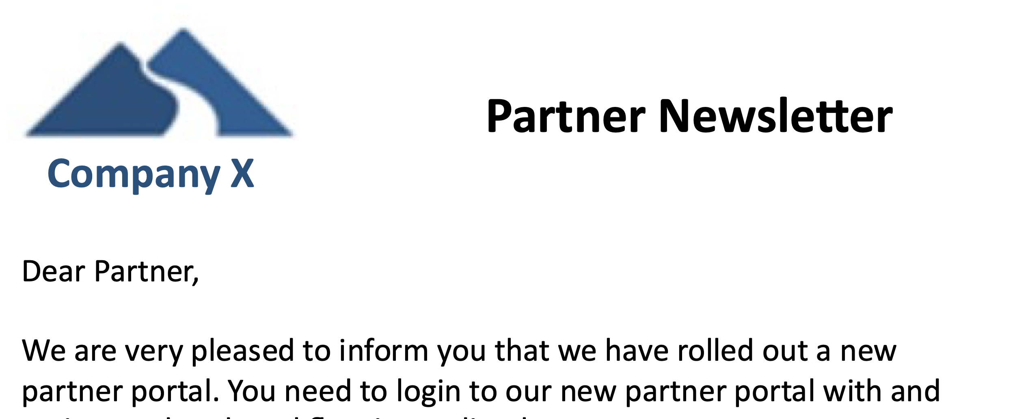






RECENT ATTACKS IMPACTING COMPANY X
eCommerce
Brand Impersonation
Website Defacement
Workforce
90-95%
Exec Phishing Uptick
Insider Threat – Malaysia OT
Infrastructure & Supply Chain
IT Operations
Supply Chain
Supply Chain

Slide 14
LEARNINGS FROM THE COLONIAL ATTACK
Capability
Colonial
Our Organization
Identify
Colonial did not have an up to date inventory of their users and assets and they had big gaps in their vulnerability assessment program.
We still have some gaps in our cybersecurity visibility and vulnerability management program but have made good progress in recent months.
82% visibility
Protect
Attackers breached Colonial’s network through a compromised credential and were able to quickly penetrate deep due to a flat network.
We continue to invest in protective controls. This year we are deploying MFA and EDR. We are reducing mean-time-to-patch below 30 days.
$37M
Detect
Colonial’s detection capabilities were hampered by their lack of visibility into user activity and the connections between their IT and OT networks.
We have invested heavily in our monitoring capabilities. Our 24x7 SOC keeps a vigilant eye out for anomalies in traffic patterns.
Respond
Colonial did not have a good response plan for attacks to the IT network. They had to shut down their OT network as a precautionary measure.
In case of breach, we have a detailed plan to limit damage, contact the authorities and inform our customers.
Recover
Notes:
Use this slide to show how your security framework (NIST) can be used to analyze breaches in the news.
A common question Board members ask is, ‘Are we secure? Can this happen here?’ Your logical analysis of the situation, and how it fits in with the overall story you have been telling them will go a long way in earning the board’s trust.
This might also be the time to highlight big gaps in your security program and ask for the financial support and mandate you need from the board to close the gap. Quantifying the level of risk in money units will get your point across to the board.

Slide 15
Summary of Last Update to Board
AGENDA
Risk Landscape Update
Cyber Risk Performance Metrics

Slide 16
RISK SNAPSHOT AND TREND
Breach Risk Trend
$37M
48%
$77M
$M
Risk
Likelihood
Impact
There is a 48% chance that we will have an impact of $77M from a cybersecurity event this year.
Editable
Notes:
You should substitute your values for Breach Risk, Likelihood and Impact as appropriate. The trend chart can be updated by right-clicking and selecting “Edit Data in Excel”.
It is critical that you use a consistent, data-driven and therefore defensible approach for constructing and populating your risk dashboard.
These widgets can be also automatically generated by Balbix.
Remember to lead with emotion when presenting these numbers. Most members of the board will take the cue from how you present this data interpret these numbers as good, neutral or bad. $37M of cyber risk may be completely acceptable or not depending on the size and risk appetite of your business.
You must resist the urge to sugarcoat things and paint an overly optimistic (“all green”) picture of cybersecurity posture. Experienced board members will see right through this.

Slide 17
RISK BY BUSINESS UNIT AND ATTACK TYPE
Risk Snapshot by Business Unit
Breach Risk Trend
Breach Likelihood by Attack Type
Editable
Notes:
You should substitute your business unit names and values. The two bar charts can be updated by right-clicking and selecting “Edit Data in Excel”.
All three widgets can be automatically generated by Balbix by analyzing data from your IT, cybersecurity and business tools or from your cybersecurity data lake.
This is the slide where the board gets to really understands the amount of risk you are carrying. Again $17M of risk in the “Industrial” business unit may be completely acceptable or not depending on your overall business situation. Make sure you provide appropriate commentary with the appropriate emotion to help the board interpret these numbers as what they mean to you.
The Trend widget is the most important widget on this slide. Trends in general help you tell the story f your cybersecurity program. Board members like trends.

Slide 18

RISK DETAIL HIGHLIGHT
Breach likelihood for the business units: Industrial’s Risk continues to be very high.
This is due to an increase in the absolute number and frequency of attacks on our organization. Top attack vectors are phishing and unpatched perimeter systems.
We are working hard to mitigate this risk by rolling out better capabilities to identify, prioritize and mitigate vulnerabilities. For phishing, we are rolling out better Email security. Some progress has been made as evident in recent risk reduction for the business unit: Lighting.
Top Projects
Real-time Visibility
Automated Vuln Mgmt.
Email Security
Notes:
Edit this slide to provide your interpretation of the quantitative data you presented in the previous two slides.
The first widget on the right is a screenshot from the 1st bar chart of the previous page.
Remember, to provide your commentary with emotion: optimistic, neutral or bad news based on how you want the board to feel.

Slide 19
STRATEGIC INITIATIVE: AUTOMATION
Industry avg. for MTD is 15 days, MTTR is 120+ days
Our MTD is now <1hr, MTTR is 6 days
Identification of vulnerable and risky assets
Our exposure
Emergence of Risk, e.g., newly discovered vulnerability
Resolution
Automating identification, evaluation and resolution of cyber-risk
t_{X}
t_{D}
t_{R}
time
Mean Discovery Time (MDT)
Mean Time To Resolve (MTTR)

Slide 20
PROGRESS IN CYBERSECURITY POSTURE
Capability
On Track
Delayed
On Hold
Roadmap
Initiatives
Identify
Implement continuous cybersecurity posture visibility. Build risk owner’s matrix and update quarterly.
Deploy Balbix
Asset Criticality Analysis
Build risk group hierarchy and assign risk owners
Implement strong identity with adaptive authentication. Improve security hygiene and patching posture. Update email security.
Build Balbix workflows for non-patching risk items
Turn on Okta adaptive auth
Protect
Deploy Okta
Improve Patching Posture using Balbix
Deploy Proofpoint or similar tool
Detect
Incorporate threat feeds in SOC workflows.
Integrate Recorded Future in SOC
Respond
Improve incidence response with automated playbooks
Integrate TBD SOAR platform in SOC
Recover
Review & update business continuity plan every quarter
Review & identify gaps in plan with risk owners
Develop plan update to address gaps
Implement & test plan
Notes:
Use this slide to provide a progress report on the major Infosec projects.
Your main objective is to provide assurance that you are effectively managing to your strategic roadmap and to answer questions about successes, setbacks, and changes in priorities. Be prepared to discuss any project you list on this slide.

Slide 21
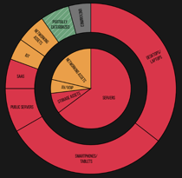
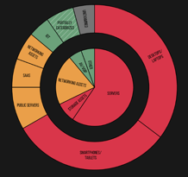
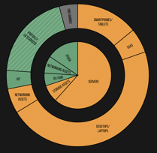
PROGRESS IN CYBERSECURITY POSTURE
Breach Risk Change and Target State
Q4 ‘20
Today
Target for Q2’22
Notes:
This might be the slide that your board members remember the most. Things are getting greener and yellower, so that is good.
This widget can be automatically generated by Balbix.

Slide 22
EXECUTIVE SUMMARY
1.
2.
3.
What is our threat landscape in 2021 - how are we doing?
What is our cyber risk from attacks via our vendors?
What is our readiness for ransomware scenarios?
Cyber Attacks are Significantly Up
Phishing attacks are up significantly
New CVEs with exploits in the wild are being disclosed at a faster rate
25% likelihood of a significant breach via a supply chain attack
Double down on visibility
Revisit and update supply chain security standards and contracts
60% likelihood of ransomware incident with expected loss $10M
Invest in automation to detect and mitigate critical risk issues quickly
Business risk-based security tools to help identify top scenarios
Notes:
Change this slide to summarize the last few topics that were covered in the previous board meeting. This is your opportunity to update the board on any open items or follow up from that discussion.

Slide 23
APPENDIX SLIDES

Slide 24
INFOSEC MANAGES BUSINESS-LEVEL RISK
Cyber Breach Risk
Compliance Risk
Strategic Risk
Operational Risk
Financial Risk
Reputational Risk
A theft of IP leads to bad press and long term value loss
A ransomware attack leads to downtime and loss of revenue
A compliance violation leads to a big fine and bad press
Loss of customer data results in bad press and harms customer trust.
Notes:
Customize this slide with ‘bad outcomes’ that are specific to your organization.
Use this slide to make the connection between information and compliance risk and Board-level business risks. It is very important that the Board understands that your presentations are centered around managing business risks that can harm the organization’s strategic objectives rather than around low-level technical details that do not merit Board-level concern.

Slide 25
THE BOARD’S ROLE IN CYBER RISK OVERSIGHT
5 Principles of Effective Cyber Risk Oversight: Guidance by National Assoc. of Corporate Directors
1
Boards should approach cybersecurity as an enterprise-wide risk management issue, not just an IT issue
2
Boards should understand the legal implications of cyber risk as they apply to the company’s specific circumstances
3
Boards should have adequate access to cybersecurity expertise, and discussions about cyber-risk management should be given regular and adequate time on the board meeting agenda
4
Boards should set the expectation that management will establish an enterprise-wide cyber-risk management framework
5
Board-management discussion about cyber risk should include identification of which risks to avoid, accept, and mitigate or transfer through insurance, as well as specific plans
Source: National Association of Corporate Directors, Cyber-Risk Oversight Handbook, 2020
Notes:
Note: This slide uses the National Association of Directors’ guidance because it is broadly applicable across industry. Chat with your CEO to understand if your Board follows a different set of guidelines, and then change this slide appropriately.
Information Sources:
National Association of Corporate Directors: https://www.nacdonline.org/cyber
U.S. Securities and Exchange Commission: https://www.sec.gov/spotlight/cybersecurity.shtml

Slide 26
THREE LAYERS OF INFORMATION RISK MANAGEMENT
Layer 3. Internal Audit
Internal Audit provides the final assurance that information risks are being managed within the organization’s risk appetite.
Internal Audit
Layer 2. Risk Management
Legal
HR
Responsibilities:
Mapping assets to risk owners
Identifying and quantifying known and emerging risks
Setting up and facilitating risk management workflows
Information Security
Compliance
Privacy
Business Segment
Business Unit
Layer 1. Risk Owners – in IT or in the Business Units
Responsibilities:
Owning and managing risks, e.g., patching software
Maintaining effective security controls
Making daily risk management decisions
Site
Notes:
The goal of this slide is to make is that the Board understands the Infosec team leads a broad cross-functional risk management effort. Cybersecurity is not simply “the Security team’s problem.”
If you do not have a formal Internal Audit function at your organization, you should merge Layers 2 and 3 and change the title of this slide.

Slide 27
OUR INFOSEC FUNCTION IN DETAIL
CISO and Deputy CISO
Manage Information Security Risk
Manage Compliance and 3rd Party Risks
Interact with CEO and Board
Manage Incident Response
Manage Security Architecture
Respond to Regulatory Requirements
Manage Data Classification
Risk Management Strategy
Monitor Systems and Events
Manage Vulnerabilities and other risk items
Maintain Records Management and E-Discovery
Manage Business Continuity and Disaster Recovery Plans
Drive Ownership And Accountability
Operate Security Controls
Evaluate and oversee deployment of new security tools
Manage Data Privacy
Manage Employee Awareness & Training
Manage Information Security Budget
Manage Third-Party Risks
Manage Information Security Vendors
Hiring and Training
Measure Metrics and Performance
Notes:
Customize this slide to represent the full set of activities and sub-activities performed by your Infosec team, and the corresponding responsibilities.

Slide 28
CYBERSECURITY POSTURE PROJECTS
Capability
Initiatives
2021
2022
Identify
Implement continuous cybersecurity posture visibility. Build risk owner’s matrix and update quarterly.
Deploy Balbix
Asset Criticality Analysis
Build risk group hierarchy and assign risk owners
Implement strong identity with adaptive authentication. Improve security hygiene and patching posture. Update email security.
Build Balbix workflows for non-patching risk items
Turn on Okta adaptive auth
Protect
Deploy Okta
Improve Patching Posture using Balbix
Deploy Proofpoint or similar tool
Detect
Incorporate threat feeds in SOC workflows.
Integrate Recorded Future in SOC
Respond
Improve incidence response with automated playbooks
Integrate TBD SOAR platform in SOC
Recover
Review & update business continuity plan every quarter
Review & identify gaps in plan with risk owners
Develop plan update to address gaps
Implement & test plan
Notes:
Use this slide to provide an overview of your Infosec projects, and how they will serve to improve your cybersecurity posture.
Your main objective is to provide assurance that you are effectively managing to your strategic roadmap and to answer questions about the goals. Be prepared to discuss any project you list on this slide.

Slide 29
If you found these slides useful…
delete this slide after use
Balbix can help you with many critical pieces of your Infosec program.
The Balbix platform uses AI to help discover and analyze your assets and attack surface to Identify areas of greatest risk. This is foundational to effective capabilities for Protect , Detect , Respond and Recover .
Balbix will automatically and rigorously quantify your cyber risk in $s.
Balbix also enables you automate critical elements of your cybersecurity program and quantify changes in risk as you improve your cybersecurity posture. The next few slides has some additional examples of this.
Start your free Balbix trial >>>

Slide 30
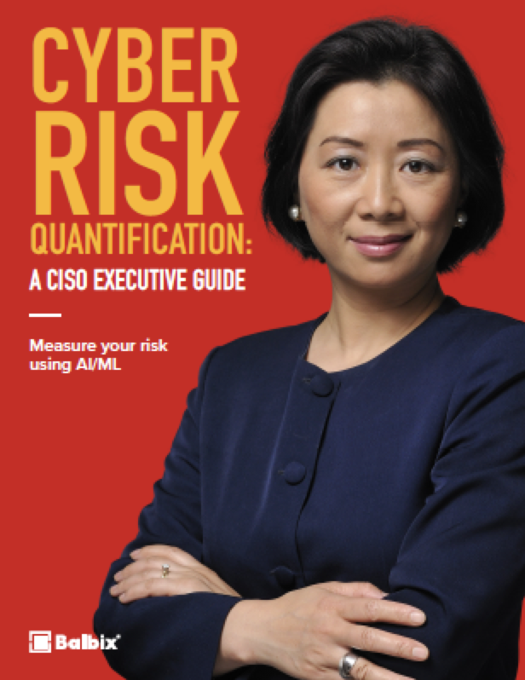
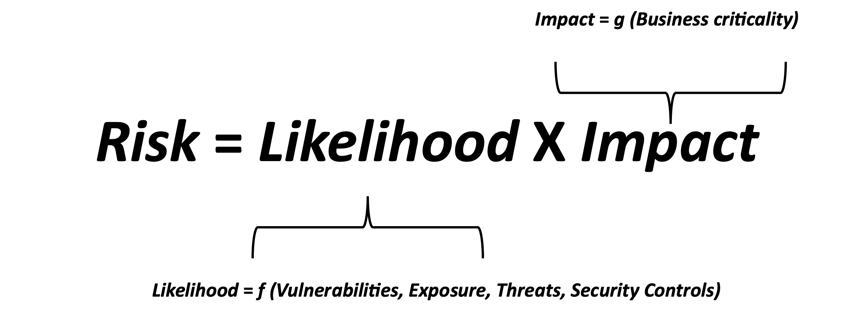
CYBER RISK QUANTIFICATION
delete this slide after use
You can learn more about how to rigorously estimate your cyber risk in money units by analyzing data from your various cybersecurity, IT and business tools.
Download this eBook at https://www.balbix.com/resources/how-to-calculate-your-enterprises-breach-risk/

Slide 31
IDENTIFY
delete this slide after use
Maturity Level
Incomplete or manual inventory
Incomplete and non-continuous vulnerability assessment
Continuous asset discovery and inventory
Continuous vulnerability assessment across 100+ attack vectors incl. people
Can quantify the impact of deployed mitigations on risk
Previous level capabilities
New vulnerabilities and risk items are automatically mapped to risk owners
Risk owners are notified about risk items that require action
Previous level capabilities
Risk is understood in units of currency
Different mitigation scenarios are simulated and compared
Partial
Informed
Repeatable
Adaptive
Balbix can help your organization implement all capabilities that are needed for Adaptive Level Maturity for Identify.
Start your free Balbix trial >>>
Notes:
Identify is the foundational layer in the NIST cybersecurity framework. You cannot protect what you don’t know about!
The 1st Identify capability that your cybersecurity program needs is: automatic and comprehensive discovery of enterprise assets (devices, applications, services and users) across on-prem, cloud and 3rd parties.
The 2nd piece is continuous assessment for vulnerabilities and risk items for all enterprise assets (including people) across 100+ attack vectors.
The 3rd capability you need is mapping risks and vulnerabilities at the device-network level to business units and risk owners, and quantifying risk in money terms.
Because of the size and complexity of the attack surface, “Identify” is not a human scale problem anymore. https://www.balbix.com/product-overview/why-balbix/
We built Balbix specifically to harness the power of advanced AI and provide these capabilities for you. You can request a demo (https://www.balbix.com/request-a-demo/) or start your free trial. (https://www.balbix.com/free-signup/).

Slide 32
PROTECT
delete this slide after use
Maturity Level
“Partial” maturity level for Identify capabilities
Some basic protections in place such as anti-virus and Internet firewall
“Informed” or higher maturity level for Identify capabilities
EDR and VPN deployed, security awareness training
Continuous vulnerability management for the majority of organization’s assets
Previous level capabilities
Strong Identity
Continuous security & risk training of people
Partially segmented network
Previous level capabilities
Proactive management of vulnerabilities and risk items
Zones and Adaptive Trust
Periodic penetration testing of defenses
Partial
Informed
Repeatable
Adaptive
Balbix can help your organization implement important Identify and Protect capabilities (underlined above) that are needed for increased maturity of Protect
Start your free Balbix trial >>>
Notes:
Your 1st line of Protect capabilities is:
EDR, firewall and VPN
Continuous vulnerability management
Balbix implements continuous risk-based vulnerability management OR can integrate with your existing vulnerability tool.
As you make progress in improved Protect capabilities, Balbix will automatically detect your new mitigations and compensating controls (such as EDR) and update your risk calculation to take into account these new capabilities.
Balbix can also generate continuous dashboards and reports that tell each risk owner what open vulnerabilities, risk items and tasks that they need to worry about. Risk owners can be compared against each other and incentivized to be at the top of the cybersecurity leaderboard. This can go a long way in developing a culture of shared risk ownership and driving down risk.

Slide 33
DETECT
delete this slide after use
Maturity Level
“Partial” maturity level for Identify capabilities
Security Operations Center (SOC) not implemented
“Informed” or higher maturity level for Identify capabilities
Basic SOC with partial monitoring coverage of security events from organization’s assets
Previous level capabilities
Advanced SOC with comprehensive monitoring and detect coverage of security events
Previous level capabilities
Proactive threat hunting capabilities
Prioritization of SOC activities based on Risk
Partial
Informed
Repeatable
Adaptive
Balbix can help your organization implement important Identify and Detect capabilities (underlined above) that are needed for increased maturity of Detect
Start your free Balbix trial >>>
Notes:
Balbix contains risk context for all your assets including software version configuration, open vulnerabilities, threats, exposure, compensating controls and asset criticality information.
This information can be accessed by your SOC team and used to prioritize their analysis tasks.

Slide 34
RESPOND
delete this slide after use
Maturity Level
“Partial” maturity level for Identify capabilities
No formal Respond Plan
“Informed” or higher maturity level for Identify capabilities
Manual Respond Plan for critical organization assets
Previous level capabilities
Automated Respond Plan for all enterprise assets
Periodic review and update of Respond Plan
Previous level capabilities
Optimized Respond Plan for all enterprise assets
Partial
Informed
Repeatable
Adaptive
Balbix’s Identify capabilities (underlined above) are foundational to implement increased maturity of your Respond Plan
Start your free Balbix trial >>>
Notes:
Balbix’s Identify capabilities are foundational to implement increased maturity of your Respond Plan.

Slide 35
RECOVER
delete this slide after use
Maturity Level
“Partial” maturity level for Identify capabilities
No formal Recover Plan
“Informed” or higher maturity level for Identify capabilities
Manual Recover Plan for critical organization assets
Previous level capabilities
Automated Recover Plan for identified critical assets
Periodic review and update of Recover Plan
Previous level capabilities
Recover Plan optimized for timely restoration of assets and functions based on business criticality
Partial
Informed
Repeatable
Adaptive
Balbix’s Identify capabilities (underlined above) are foundational to implement increased maturity of your Recover Plan
Start your free Balbix trial >>>
Notes:
Balbix’s Identify capabilities are foundational to implement increased maturity of your Recover Plan.

Slide 36
CYBERSECURITY POSTURE AUTOMATION
delete this slide after use
Owner Review
Manual or Automated Fix/Mitigation Steps
Automatic Validation
Global Threat & Vulnerability Data
Dashboards & Reporting
Per-owner Prioritized list of Vulnerabilities and Risk Items
Accept Risk for some issues and document reasons
Prioritized list of Vulnerabilities and Risk Items
Assign to another owner
Automatic Asset Inventory
Continuous Assessment of Vulnerabilities and Risk Issues
Evaluation of Vulnerabilities and Risk Issues
Dispatch to Risk Owners
Periodic Review of Exceptions
Balbix sensors and other IT and Cybersecurity Data Sources
Some risk Issues are automatically accepted based on specific enterprise context
Notes:
Here is a picture that shows how automated cybersecurity posture works.
Starting from the left, we first build and maintain automatic asset inventory.
We also perform continuous assessment of vulnerabilities, we can bring in the global threat information, and then based on the business and security context that we have in Balbix, we evaluate those vulnerabilities, we prioritize them, we suppress certain of them based on mitigations we might have, what things you may have decided to postpone.
Then we automatically dispatch prioritized lists of vulnerabilities and risk items to the various risk owners. Until this point onwards, everything is automated.
Every one of the owners get their own dashboards with their own set of prioritized issues, kind of like a mini-organization. Each issue has to be either remediated, mitigated or accepted.
Owners can configure different groups of assets, e.g., auto-update assets, test-and-patch assets and do-not-patch assets, and each of these groups is handled differently from a automation perspective.
Balbix is also continuously validating vulnerabilities and risk items. Metrics is automatically updated in the Balbix dashboard, and reports are automatically triggered for various stakeholders.
Deployment of Balbix will enable you to drive mean-time-to-resolve down to hours or days from weeks and months.

Slide 37
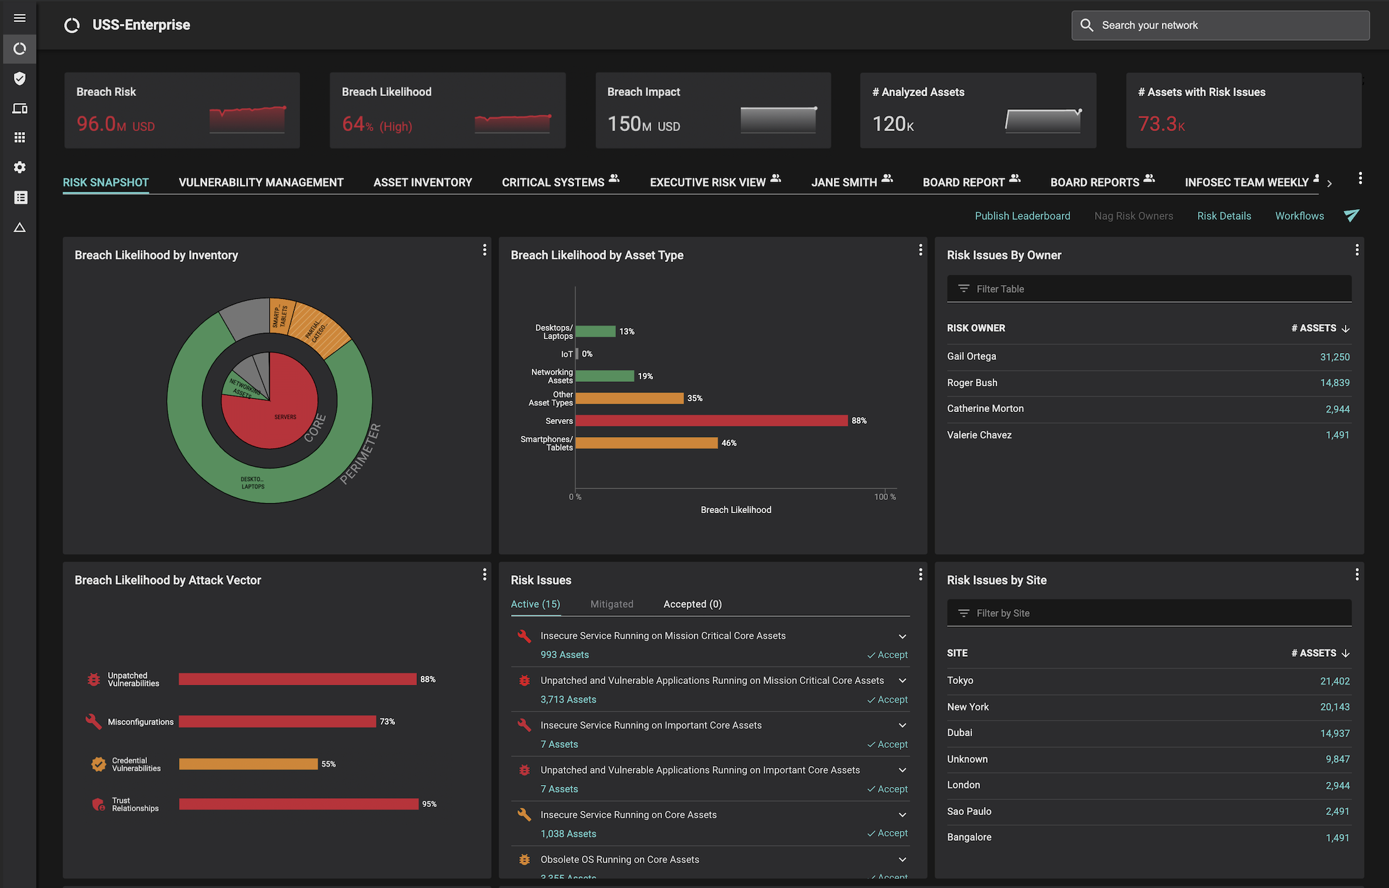
LEARN MORE ABOUT BALBIX
In 30 minutes, we will show how Balbix can help you automate your cybersecurity posture.
With Balbix, you will use AI, automation and gamification to discover, prioritize and mitigate your unseen vulnerabilities at high velocity.
You will also be able to quantify your cyber risk in $-terms, traceable to operational metrics and asset attributes driving this risk. You will be presented with practical actions you can take to mitigate this risk.
Request a Demo
https://www.balbix.com/request-a-demo/
A single, comprehensive view of cybersecurity posture

Slide 38
Good Luck!
delete this slide after use
Start your free Balbix trial >>>

