Slide 1
Template for CISO’s Presentation on the DORA Regulations
To CEOs & Board of Directors

Slide 2
General Directions
This presentation template includes key slides on the Digital Operational Resilience Act (DORA) that you can present to your CEO or the board of directors
Directions
The core presentation is Slides 3-10. Other slides contain instructions and additional materials
Customize these slides based on the unique context of your organization and industry
Use the slides in the appendix section as needed to augment the presentation

Slide 3
DORA Cybersecurity Rule Overview
April 2024
Notes:
Modify this slide to add your organization’s name and logo.
The date field is auto-updating. If you are preparing your slides for a specific date, you may want to change that.

Slide 4
Summary
1
What is DORA?
2
DORA Implementation Timeline
3
DORA Requirements
4
DORA Key Concepts
5
Most Important Concept – Materiality
6
Next Steps Toward DORA Compliance

Slide 5
What is DORA?
The DORA Act (Digital Operational Resilience Act), is part of the European Union's efforts to enhance the digital operational resilience of its financial sector. The primary aim of DORA is to ensure that all entities in the financial system have the necessary safeguards in place to mitigate cyber attacks and other risks related to their digital operations. The act goes into effect Jan 17, 2025.
For the Financial Entity
DORA aims to strengthen cybersecurity and operational resilience of financial entities and their service providers.
For the EU DORA aims to ensure the stability and integrity of the financial markets.

Slide 6
DORA Implementation Timeline
Proposal
Adoption
Review
A period of consultation and feedback from stakeholders helped shape the final regulations.
Financial entities and stakeholders prepare for the regulation's application in Jan.
2022
May 11
Jan 17
2025
2026 Jan 25
2020 Sept
2022
Nov 28
European Commission reviews to assess the need for stronger requirements regarding digital operational resilience
The European Commission proposed DORA.
The Council formally adopted DORA
Feedback
Implementation

Slide 7
DORA Requirements
ICT Risk Management | Incident Reporting | Digital Operational Resilience Testing | ICT Third-Party Risk Monitoring | Information Sharing & Intelligence
Financial entities must establish and maintain a comprehensive risk management frameworks capable of identifying, assessing, mitigating, & managing ICT risks. | Financial entities must promptly report significant cybersecurity incidents to relevant authorities, typically within 72 hours. | Financial entities must regularly test their ICT systems & processes to ensure they can withstand & recover from operational disruptions. | Financial institutions must oversee & manage risks associated with third-party ICT service providers. | Financial entities are encouraged to share information about cyber threats, vulnerabilities, incidents, & best practices.
Key Elements: Risk assessment Define policies & procedures Protection & prevention Incident response & recovery plans | Key Elements: Define reporting thresholds Timely notification Detailed reporting Mitigation plan | Key Elements: Penetration testing Scenario-based testing Testing frequency and rigor | Key Elements: Due diligence Contractual Agreements Ongoing monitoring | Key Elements: Establishing information-sharing arrangements with peers Protecting shared information Leveraging intelligence to improve cyber posture

Slide 8
DORA Key Concepts
01
MATERIALITY
This refers to the significance of an event, fact, or item. Materiality matters because it can influence decisions, affect interpretations, or change outcomes.
02
RISK ASSESSMENT/MANAGEMENT
DORA
This involves the identification, evaluation, and prioritization of risks, and the application of resources to minimize, control, and mitigate their impact. A business might assess the risk of a data breach and manage it by enhancing their cybersecurity measures.
03
INCIDENT REPORTING
This is the process of documenting all details of an event that could possibly result in personal injury or damage to property. For instance, if a worker is injured on a construction site, an incident report would be necessary to document what happened and why.
04
GOVERNANCE
Financial Orgs.
Governance refers to the structures and processes in place for managing an organization and guiding its path towards achieving its goals. An example of this could be a corporation's board of directors who set the strategic direction and oversee the management of the company.
05
OPERATIONAL RESILIENCE
This is an organization’s ability to withstand, adapt to, and recover from disruptions while continuing to serve its customers or perform its critical operations. A bank, for example, may demonstrate operational resilience by ensuring it can still operate during a power cut or cyber attack.

Slide 9
The Most Important Concept—Materiality
How does DORA define it
Who should be involved
Addressing grey areas
The significance of an incident's impact on the ICT systems and processes of a financial entity.
Takes into account factors such as the potential harm to consumers, financial markets, and the stability of the financial system.
Multiple stakeholders across leadership, risk management, compliance and cybersecurity departments.
Chief Risk Officers (CROs), Chief Information Security Officers (CISOs)
Build a playbook for identifying material incidents, disclose criteria.
When in doubt, disclose.
The 72-hour reporting window for material cyber incidents begins upon incident detection.

Slide 10
Next Steps Toward DORA Compliance
DORA
Compliance
5
4
Regularly Review & Update Compliance Measures
3
Strengthen Incident Detection & Reporting Mechanisms
2
Enhance Training & Awareness Programs
1
Develop & Implement an Action Plan
Conduct a Comprehensive Gap Analysis

Slide 11
If you found these slides helpful
Balbix can help you determine materiality and comply with DORA cybersecurity requirements.
Balbix will help you provide visibility into your all your assets and automate critical elements of your cybersecurity program and quantify changes in risk as you improve your cybersecurity posture. The next few slides has some additional examples.

Slide 12
How Balbix can help
Materiality determination
Cyber risk management
Governance and compliance
Balbix can help you determine whether an incident, application, asset, threat or vulnerability is material, by analyzing all data from IT, security, and business tools and identifying if they pose material risk to the organization
Balbix can help you to quantify and manage material cyber risks down to acceptable levels with a data-driven model that be traced to specific assets
Balbix enables you to unify cyber governance, operational cybersecurity, and compliance to enable better management of material cyber risks in a single platform

Slide 13
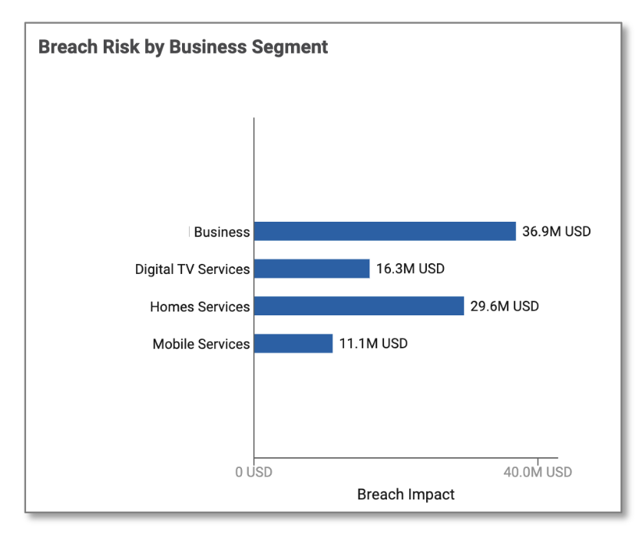
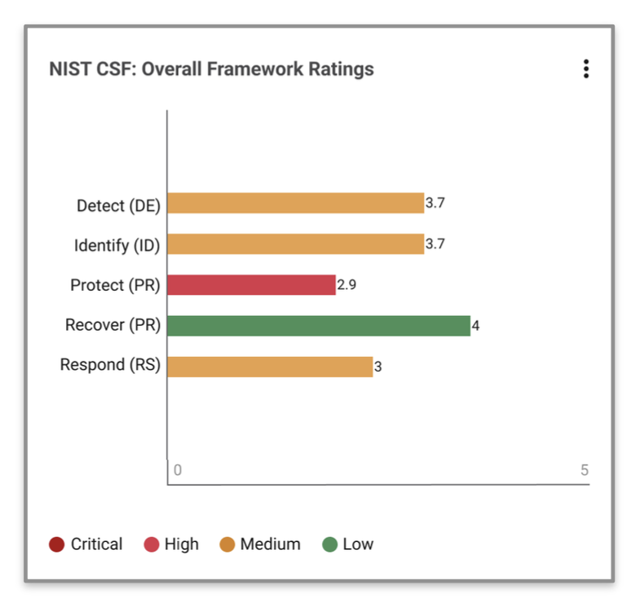
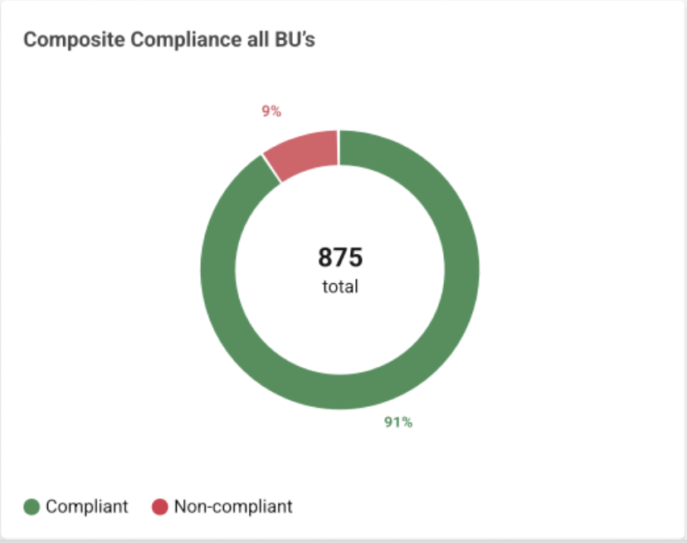
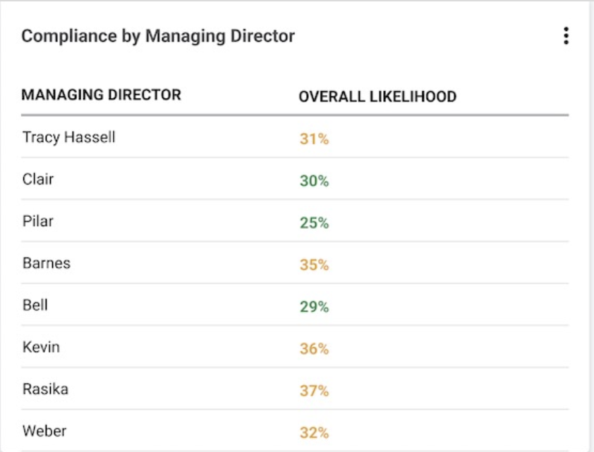
Sample Executive Risk View
Executive Risk View
Operational Risk Dashboard
Asset Inventory
NIST CSF Compliance
SEC Reporting
Board Reporting
Maturity

Slide 14
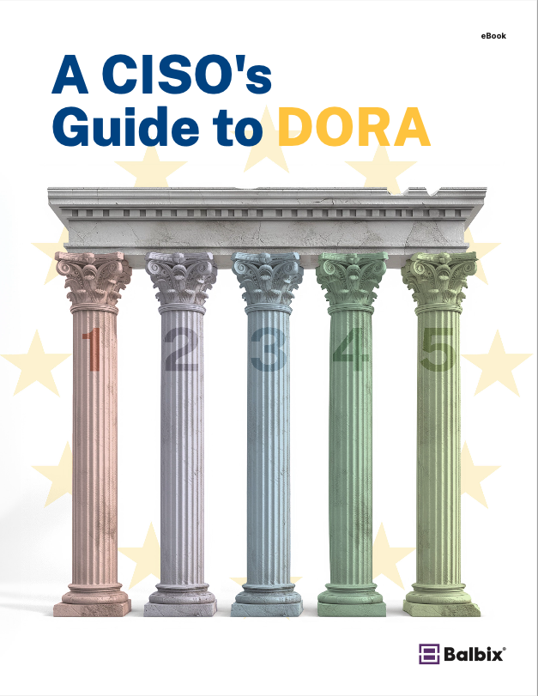
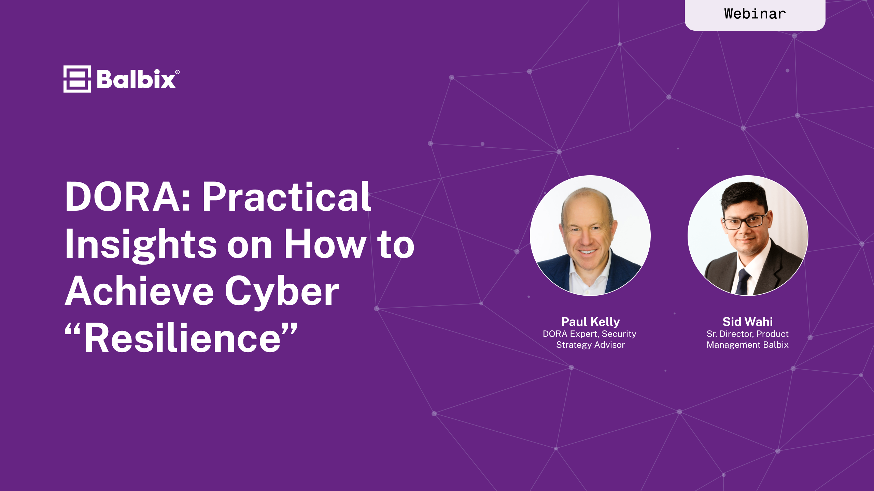
Resources
eBook
A CISOs Guide to the DORA
Webinar
Master the SEC’s latest Cybersecurity Regulation
Includes an explanation of DORA requirements and how Balbix can help address them.
What you will learn
What’s DORA’s impact on the organization?
How do you get started?
What changes might your organization need to implement DORA?
How can AI and Automation help you fast-track DORA compliance?
Download Now
Watch the Video

Slide 15
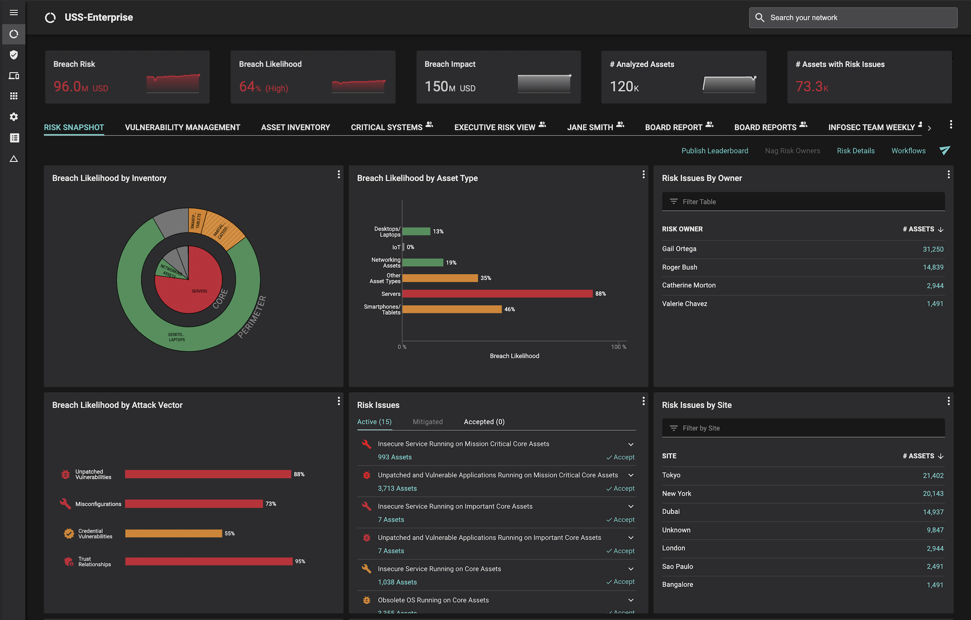
In 30 minutes, we will show how Balbix can provide visibility into all your assets including your material assets.
Additionally, you will be able to quantify your cyber risk in $-terms, traceable to operational metrics and asset attributes driving this risk.
Request a Demo
A single, comprehensive view of cybersecurity posture

